Slide 1
AGNEEPATH
AN INCREMENTAL PATH FINDING ALGORITHM
CREATED BY
TUSHAR MANGALE
SHRIKANT UBALE

Slide 2
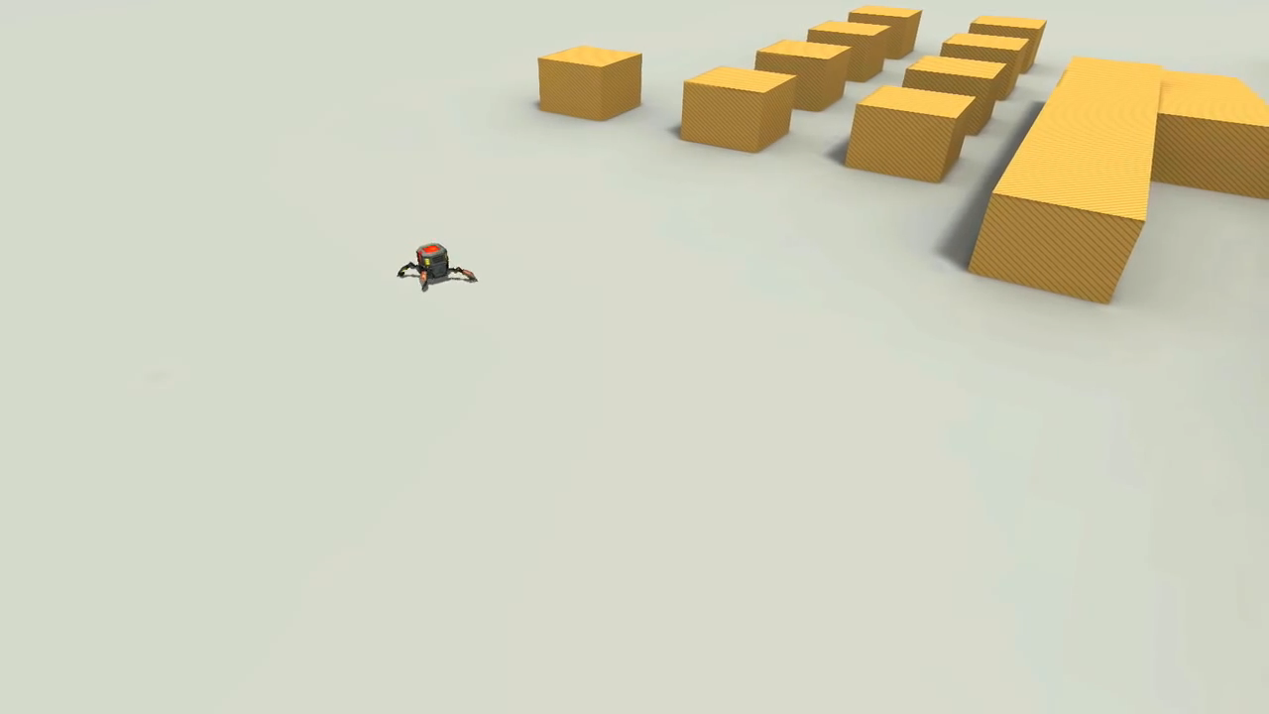
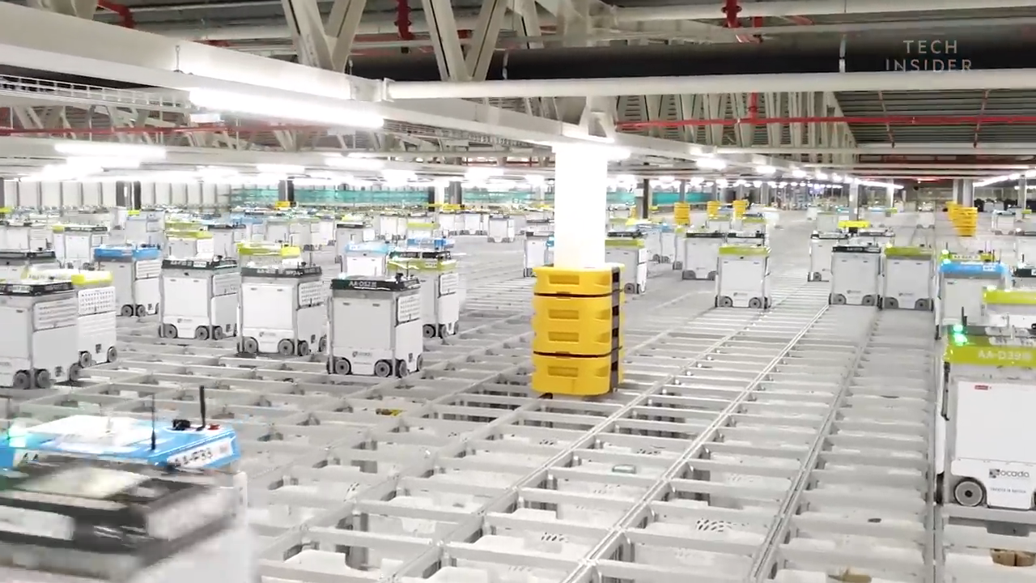
In the field of AI, calculating the best route from one point to another "path finding", has become a common problem. However in a dynamic environment where the obstacles are moving frequently, traditional path finding becomes impractical.
“AGNEEPATH" is an algorithm able to respond to changes in the environment, modifying or replacing the agent's current path in a timely fashion.
Implementations of the "Agneepath" algorithm:
A rover moving in an unpredictable environment.
A computer game where your opponent running around avoiding obstacles and players.
Warehouse robots to automate good delivery process.

Slide 3



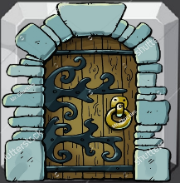
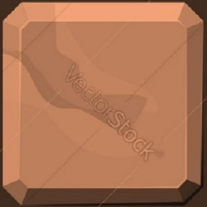


CONFIGURATIONS:
Based on A* path finding algorithm.
Horizontal/Vertical traversal.
man
fire
tile
door
wall
dragon
path

